Slide 1
Memoization in different programming languages
By: Kate Arvay, Tibor Blascsok, Antoine Geiger
Notes:
Hello and welcome to our presentation called Memoization in different programming languages. We are group 64 and this presentation Made by Antoine, Kate and I Tibor

Slide 2
Table of contents
Memoization
Python
PhP - Laravel
Java
Conclusion
References
Notes:
First we go through the basic idea of memorization, then we showcase how to implement it in three different language, python then php – Laravel and finally Java. Lastly we summarize our findings.

Slide 3
1. Memoization
What is memoization?
Why is it useful?
What factors can influence efficiency?

Slide 4

2. Python
Data handling
Practical and scalable usage
Speed comparison
Result
Figure 1.

Slide 5
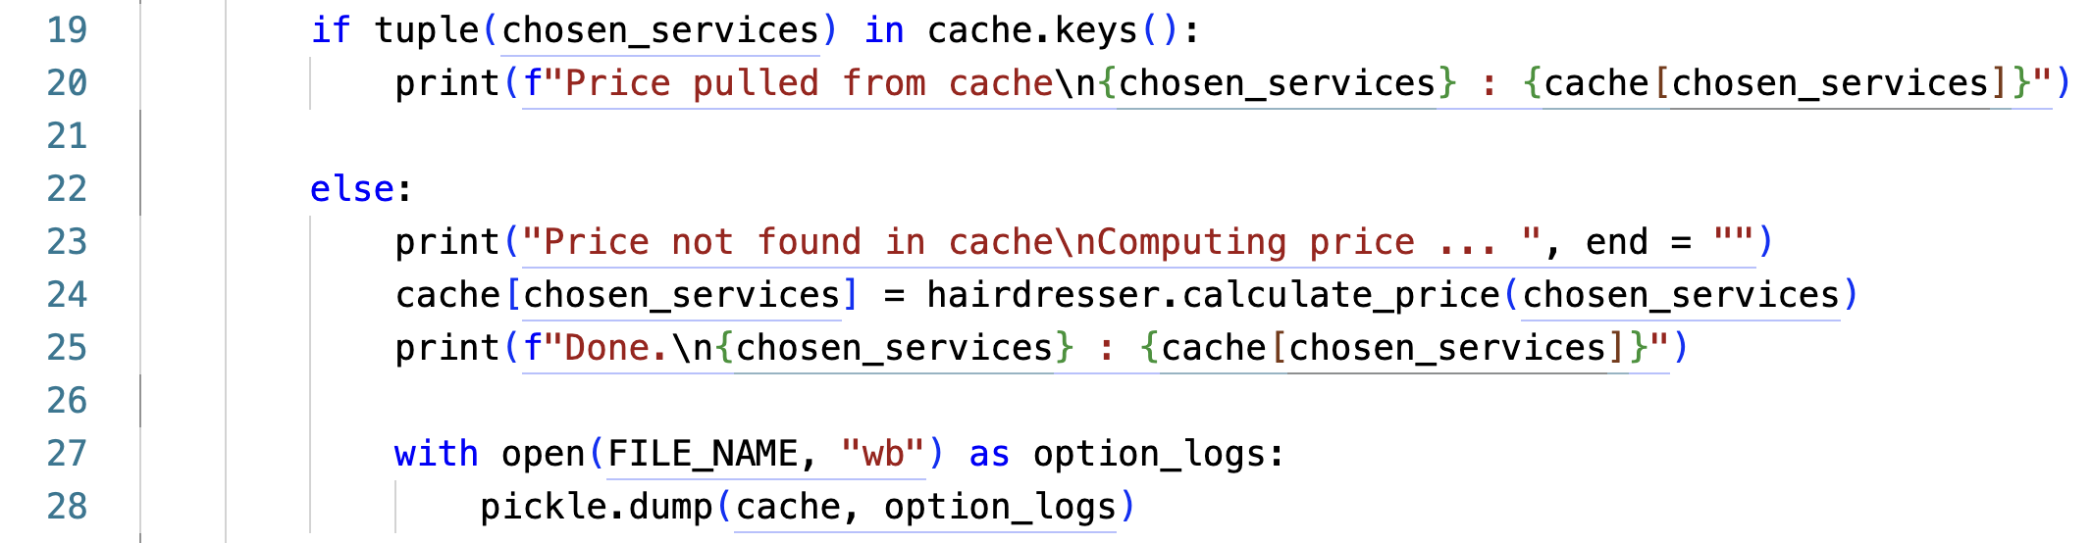
Data handling

Slide 6
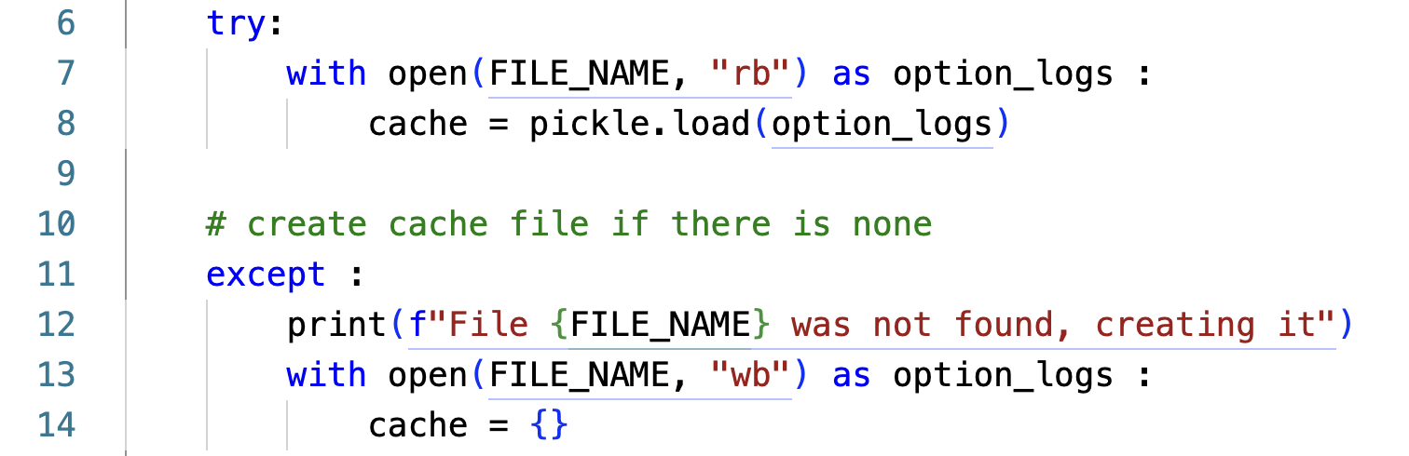
Practical and scalable usage

Slide 7
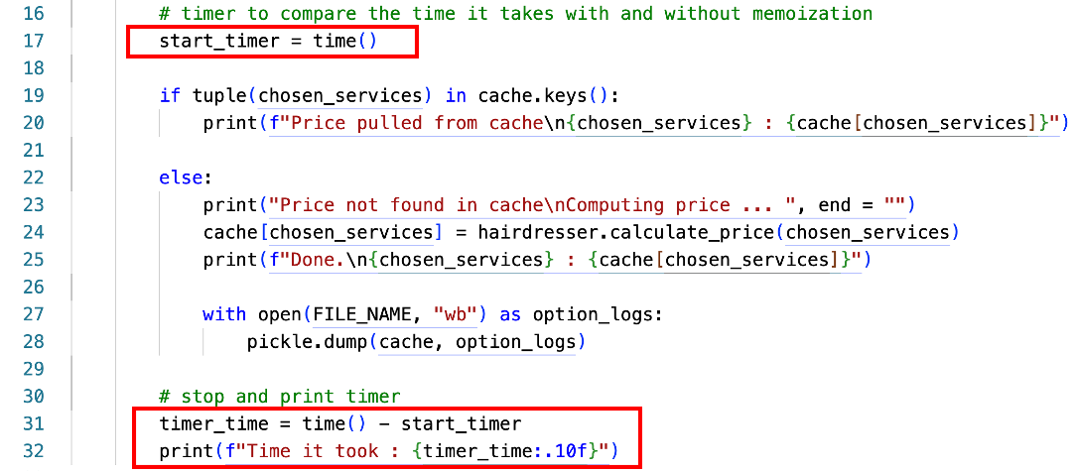
Speed Comparision

Slide 8
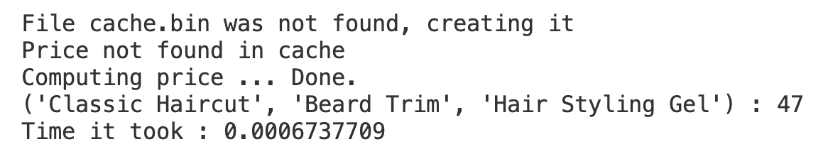
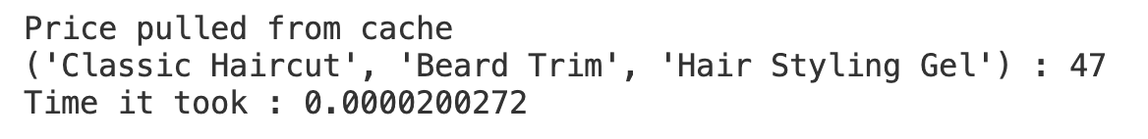
Result

Slide 9

3. PhP - Laravel
What is Laravel?
Different caching methods
Loading the site
From cache to usage
Selecting services - with and without cache
Figure 2.
Notes:
I would like to showcase memoization in Laravel, but first
What is Laravel?

Slide 10
What is Laravel?
” Laravel is a web application framework with expressive, elegant syntax.”(1)
Works efficiently with Vue or React
Multiple starter kits – Breeze, Jetstream
Notes:
Laravel is a php based, web application framework with expressive, elegant syntax
One framework which can be utilyzed as backend with multiple famous frontend languages. For example React or Vue.
Laravel comes with starter kits which helps you get started. Breeze and Jetstream which help you with authentication, user profile management. (3)

Slide 11


Different caching methods
Laravel’s built in file cache driver
Supported caching backends:
Memcached
Redis
Figure 4.
Figure 3.
Notes:
Cache in Laravel, php. For this program I used the built in cacheing method which stores the serialized, cached objects on the server’s filesystem (4), but there are different services for cacheing. For example: Memcached (a free and open source caching system which uses web server’s memory for cache) (5) or Redis (an in-memory data store which can be used as a database, cache and more) (6). For larger applications it is recommended to use one of the more robust drivers.

Slide 12
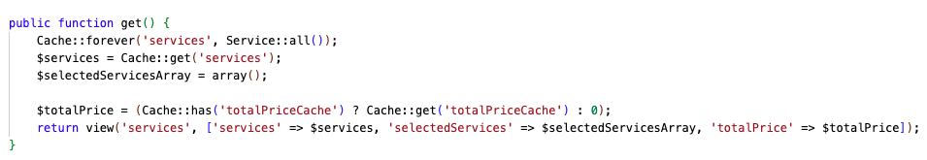
Loading the site
Storing all data from the database into the cache
Returning all needed data to load the site

Slide 13
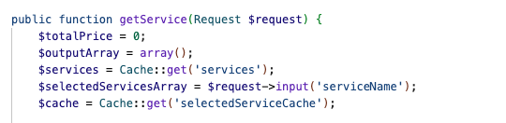
From cache to usage
Getting all the services from the cache
Getting the selected services

Slide 14

Selecting services – without cache
Checking how many services were selected
Calculating the total price
Storing the data into the cache
Slow

Slide 15
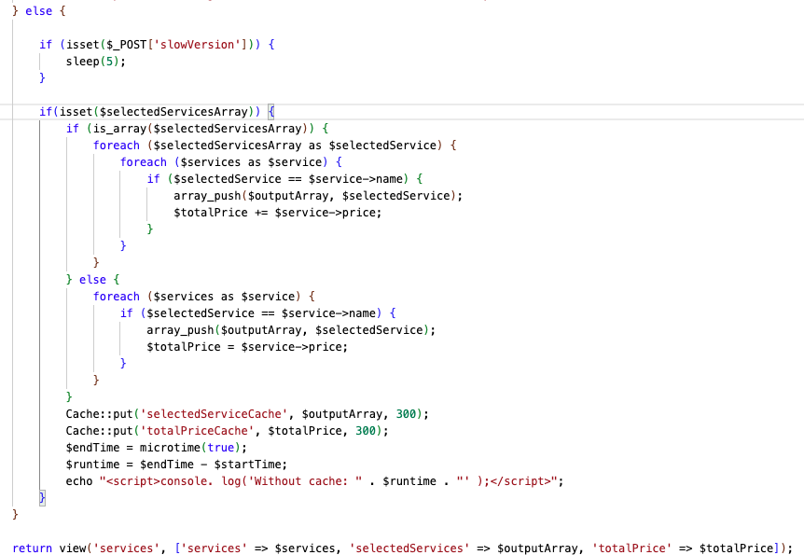

Slide 16

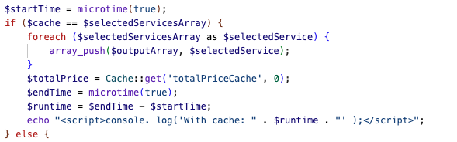
Selecting services – with cache
Get all selected services and total price from the cache
Significantly faster

Slide 17

4. Java
Implementation example
Use Case algorithm
Test Case
Execution time comparison
Figure 5.

Slide 18
Implementation example
calculating and displaying the total duration and cost of various service combinations
instead of computing the totals for same service combination, the result is retrieved from cache
caching done by using HashMap
Key: serviceCombination (hashed and stringified key (ignore order))
Value: computed total duration and total price

Slide 19
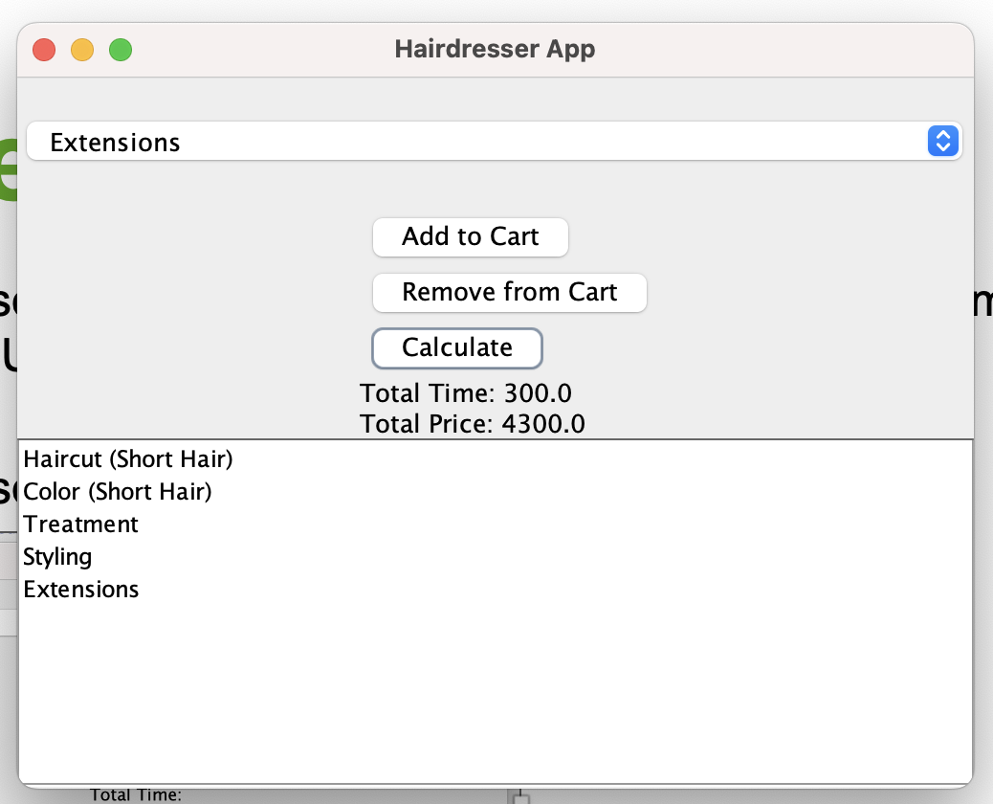
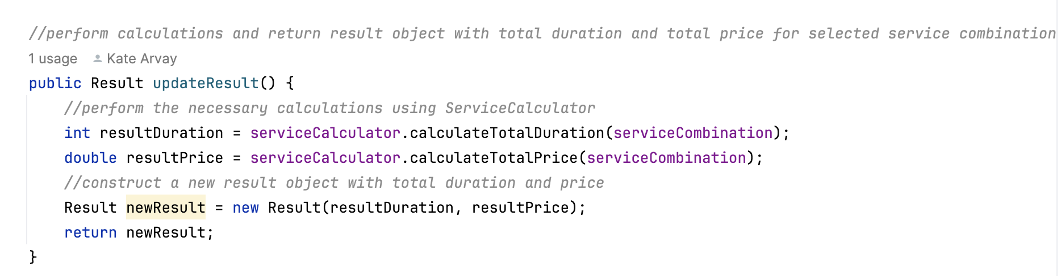
Use Case algorithm
1. user selects a service to be added to/removed from cart (service combination list and UI updated dynamically on button click)
2. user clicks “Calculate” which triggers calculation algorithm

Slide 20
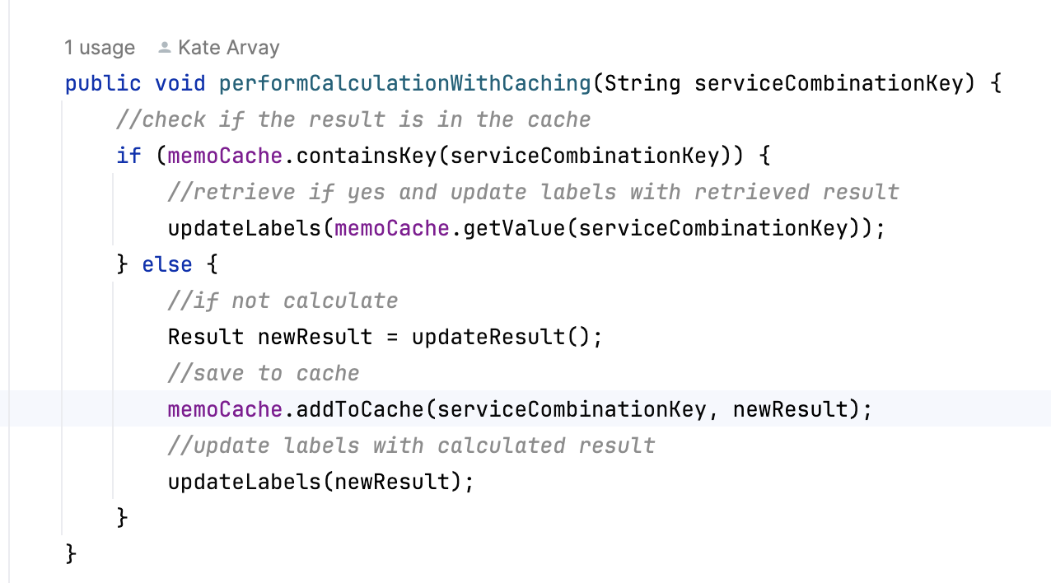
Use Case algorithm
3. checks if the value is in cache by passing key as an argument
a) key found in cache – retrieve value and update UI
b) key not found – calculate and put the service combination with the computed value in the cache, update UI

Slide 21
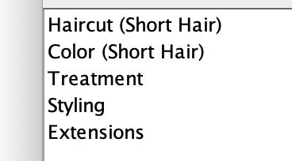
Test Case
1. Select and add following services to cart:
2. Click „Calculate“ (selected combination not in cache, will be saved to cache)
3. Observe the time log on the console (without caching)
4. Remove “Extensions“ and add them again resulting in the same service combination that is already in the cache
5. Click „Calculate” (results in cache hit, item will be retrieved from cache)
6. Observe the time log on the console
7. Compare the execution time
Expected Result: execution time for cache hit shorter

Slide 22
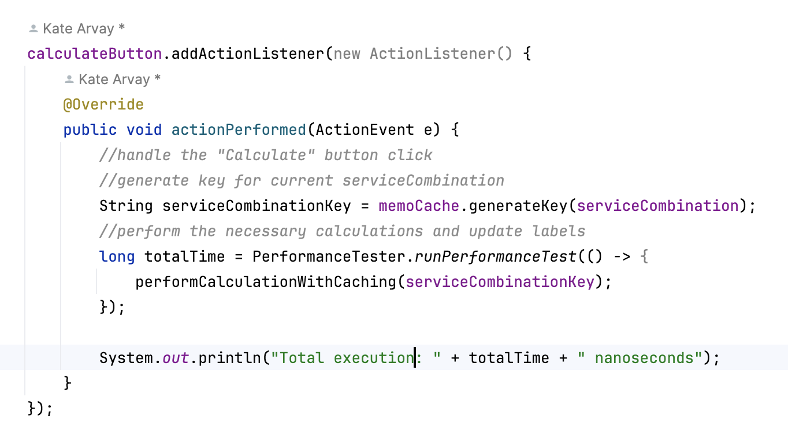
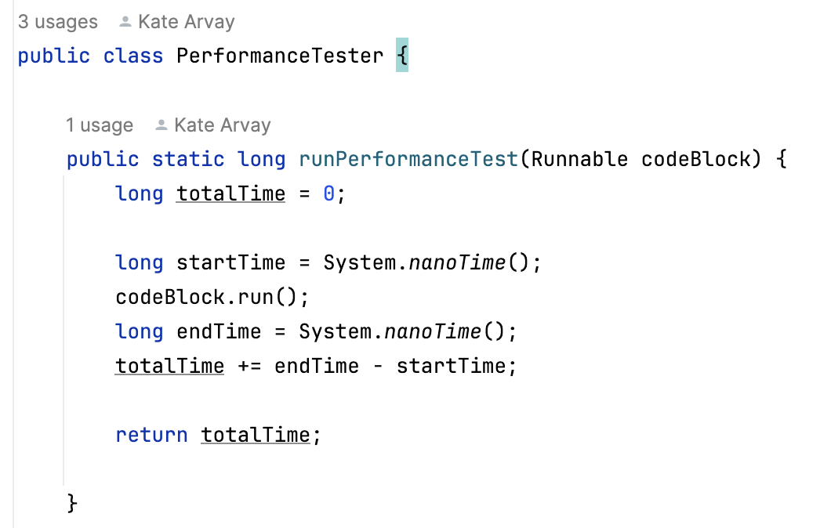
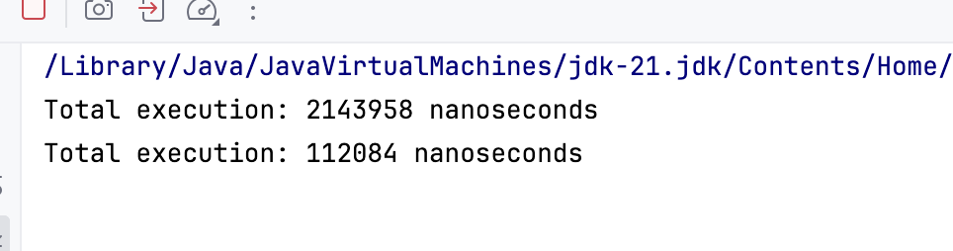
Execution Time Comparison
without cache
cache hit

Slide 23
5. Conclusion
”Memoization is a simple but powerful trick that can help speed up our code, especially when dealing with repetitive and heavy computing functions”(9)or or functions that are called frequently with the same input parameters(10)
“It is important to consider the trade-off between memory usage and computational savings when deciding when to apply memoization” (10) in real world scenarios.

Slide 24
6. References
1. Merge Three Dictionaries ChatGPT [Internet]. 2024 [cited 2024 Feb 9]. Available from: https://chat.openai.com/share/d326905e-5594-4080-912a-b69351c00089
2. The PHP framework for web artisans [Internet]. [cited 2024 Feb 9]. Available from: https://laravel.com/
3. The PHP framework for web artisans - Frontend [Internet]. [cited 2024 Feb 9]. Available from: https://laravel.com/frontend
4. The PHP framework for web artisans - Cache [Internet]. [cited 2024 Feb 9]. Available from: https://laravel.com/docs/10.x/cache
5. Dormando. A distributed memory object caching system [Internet]. [cited 2024 Feb 9]. Available from: https://memcached.org/
Redis [Internet]. [cited 2024 Feb 9]. Available from: https://redis.io/
7. Hairdresser App Memoization ChatGPT [Internet]. 2024 [cited 2024 Feb 9]. Available from: https://chat.openai.com/share/1f16ca0a-5bfa-44fa-b862-41f3c702a0ed?fbclid=IwAR27ggXZAx45ypIB_3NRzpyo6RotnJo2AAXcLvKca2yuMgw8CDXEHkHQuiM
8. Gunawardhana PL. What is memoization in react?: Syncfusion blogs [Internet]. 2023 [cited 2024 Feb 9]. Available from: https://www.syncfusion.com/blogs/post/what-is-memoization-in-react.aspx
9. Pierre-Yves Saumont. Do it in java 8: Automatic memoization - dzone [Internet]. 2014 [cited 2024 Feb 9]. Available from: https://dzone.com/articles/java-8-automatic-memoization
10. Cocca. What is memoization? how and when to Memoize in JavaScript and react [Internet]. freeCodeCamp.org; 2022 [cited 2024 Feb 9]. Available from: https://www.freecodecamp.org/news/memoization-in-javascript-and-react/
11. What is memoization in react? [Internet]. [cited 2024 Feb 9]. Available from: https://rangle.io/blog/react-memoization
12. Elevator music [Internet]. [cited 2024 Feb 9]. Available from: https://pixabay.com/music/elevator-music-elevator-music-bossa-nova-background-music-version-60s-10900/

Slide 25
6. References - Figures
1. Python logo and wordmark [Internet]. Wikimedia Foundation; [cited 2024 Feb 9]. Available from: https://en.m.wikipedia.org/wiki/File:Python_logo_and_wordmark.svg
2. Bashir ChK. Laravel logo [Internet]. 2023 [cited 2024 Feb 9]. Available from: https://www.linkedin.com/pulse/laravel-introduction-ch-khuram-bashir/
3. Memcached logo [Internet]. [cited 2024 Feb 9]. Available from: https://vmssoftware.com/products/memcached/
4. Redis logo [Internet]. [cited 2024 Feb 9]. Available from: https://www.logo.wine/logo/Redis
5. Java logo [Internet]. 2023 [cited 2024 Feb 9]. Available from: https://sandaacademy.com/sa-training-courses/programmingwithjava/

